Slide 1
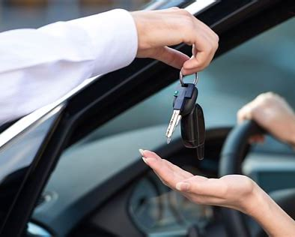
Vehicles Rental System for self driving
Book your vehicle from any where ….

Slide 2
Introduction
It is an online system through which customers can view available Vehicals,View profile and book vehicles for Self driving.
Nowadays, vehicles become one of the basic thing in human life.
Every one use to book ola,rapido,uber etc.. But in all of them a person will pick you and drop you they will not give the vehicles.
Many advantages in vehicle rental system rather than booking trips in ola,rapido.

Slide 3
Admin Module
Admin can create vehicle brands
Post Vehicles
Manage Vehicles
Manage to contact us Query
Admin can edit the details of registered users
Admin can also update the page content
Admin Dashboard
Change Password
Logout

Slide 4
User Module
View Available vehicles
Book Vehicles
Update His/Her profile
Update His/Her password
Logout

Slide 5
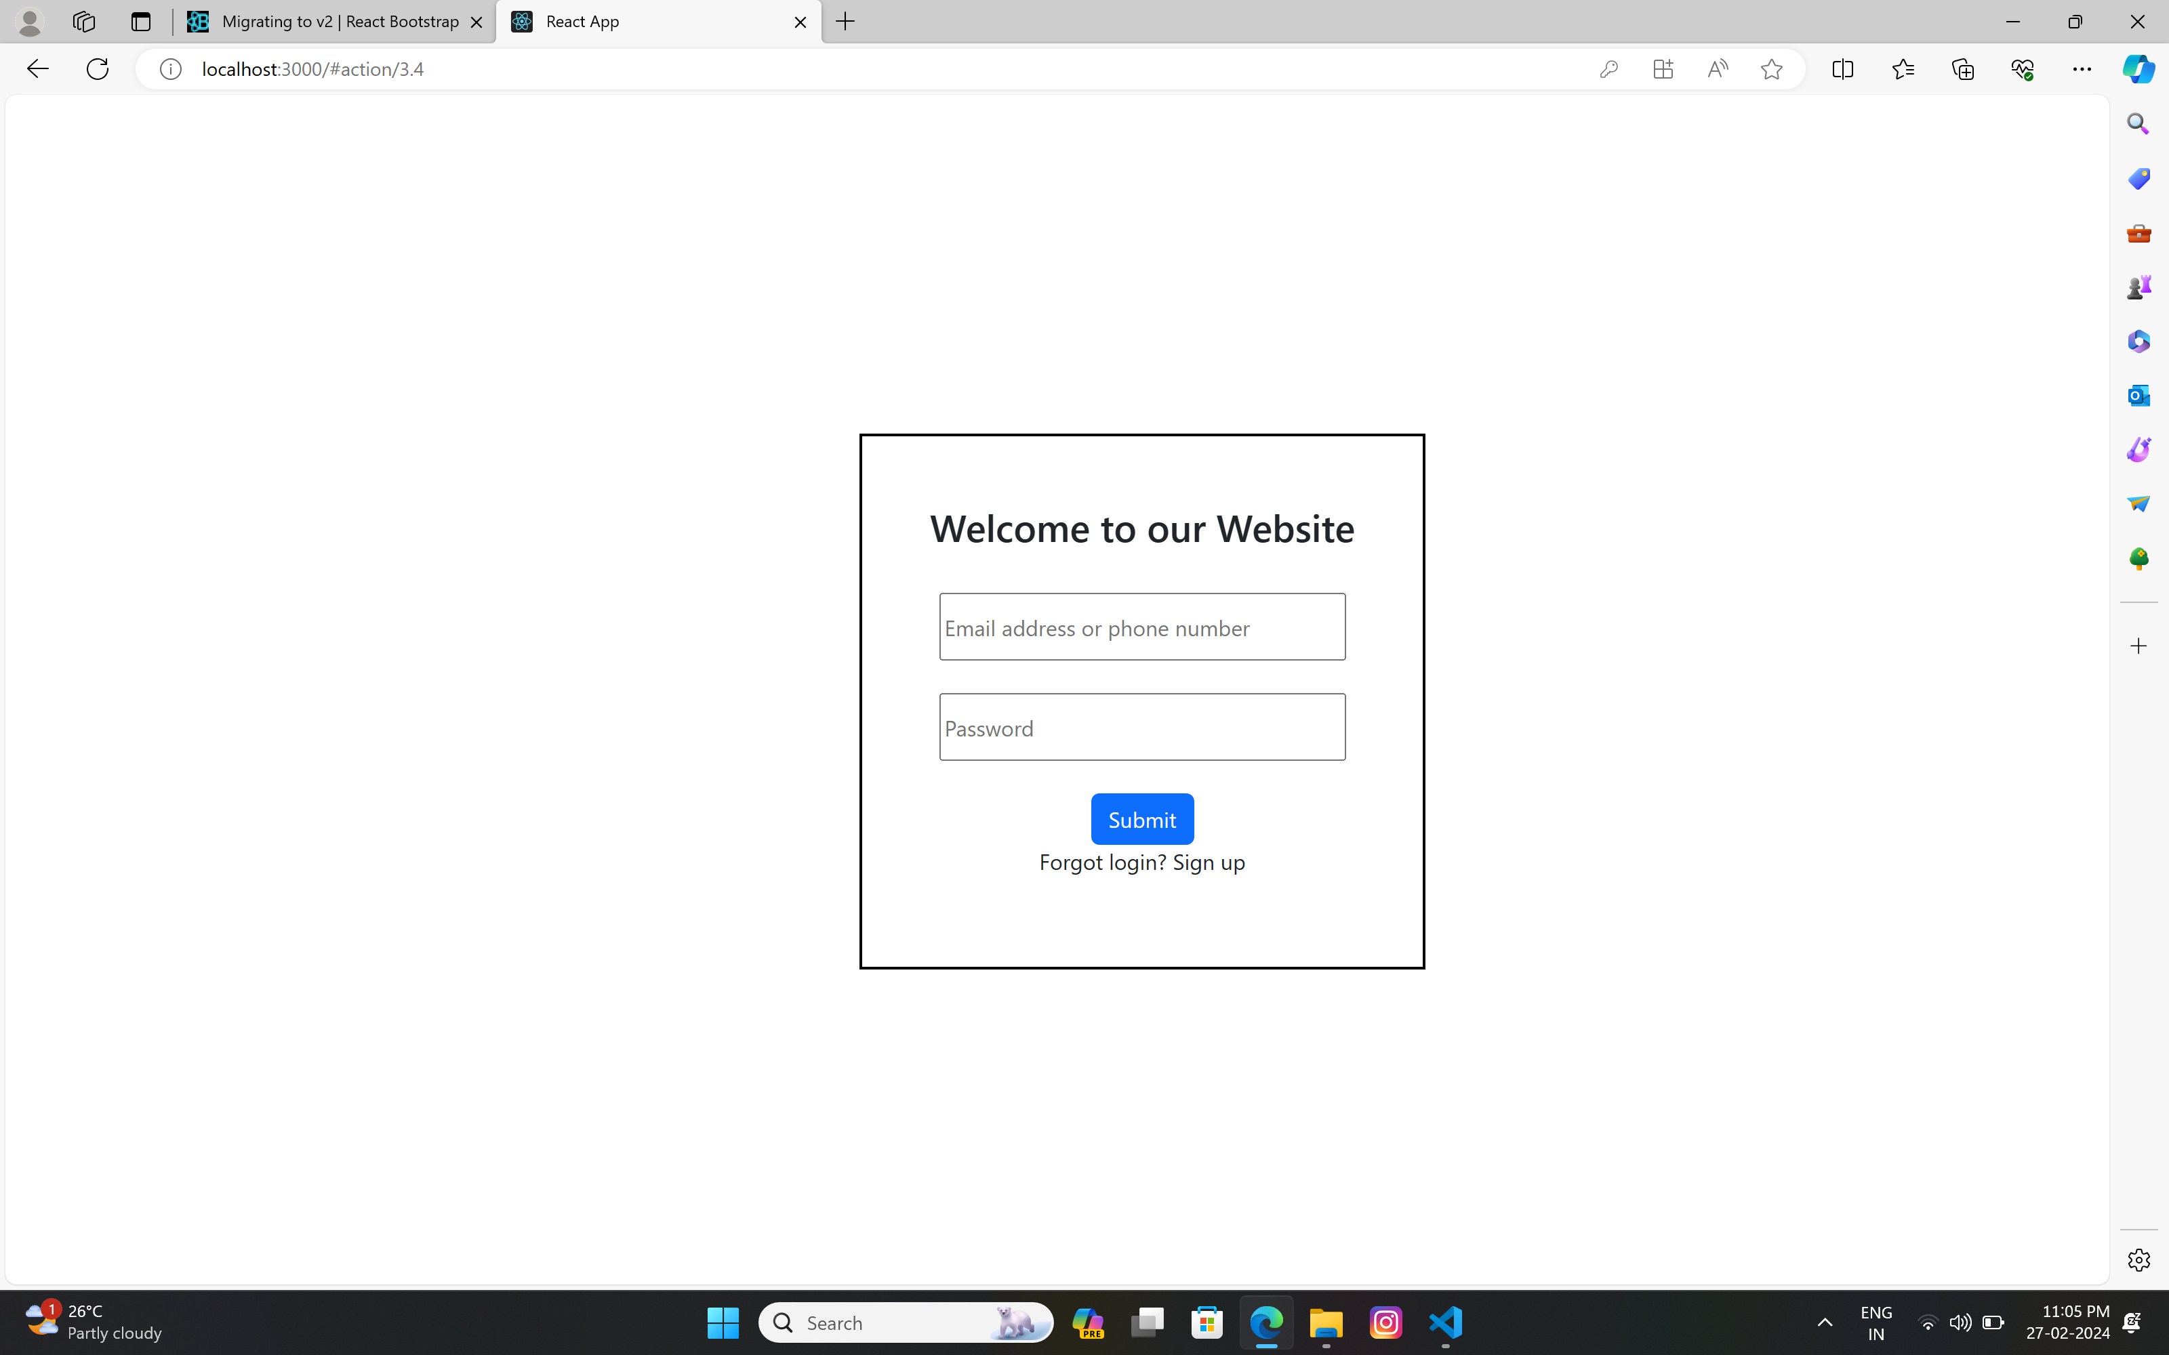
Login page

Slide 6
Requirement specification
SOFTWARE REQUIREMENTS
Language Used: Python
Database : MySql
User Interface Design: HTML,CSS,JAVA SCRIPT
Frame Works: Django,React Js
HARDWARE REQUIREMENTS
Processor: Inter(i3) Pentium Dual
RAM: 2 GB

Slide 7
Advantages
This online vehicle rental system is a fully functional and flexible.
It saves a lots of money,time and labour for user.
It provides custom feature development and support with software.
The software is available for 24/7.

Slide 8
Feature scope
Automation of the entire system improves the efficiency.
It provides a friendly graphical user interface.
It gives appropriate access to the authorized users depending on their permissions.
It effectively overcomes the delay in communications.
Updating of information becomes so easier
System security, data security and reliability are the striking features.
The system has adequate scope for modification in future if it is necessary.

Slide 9
Conclusions
The solution was to provide self drive vehicles for rent with an user-friendly web application that would allow for customers to access and use on a wide range of devices:Desktops,laptops,mobile devices,tablets.
The website is designed to stay up to date by giving administrators the ability to change/add/remove any featured vehicles on the site.
Simple and easy to use.

Slide 10
THANK YOU

